Slide 1
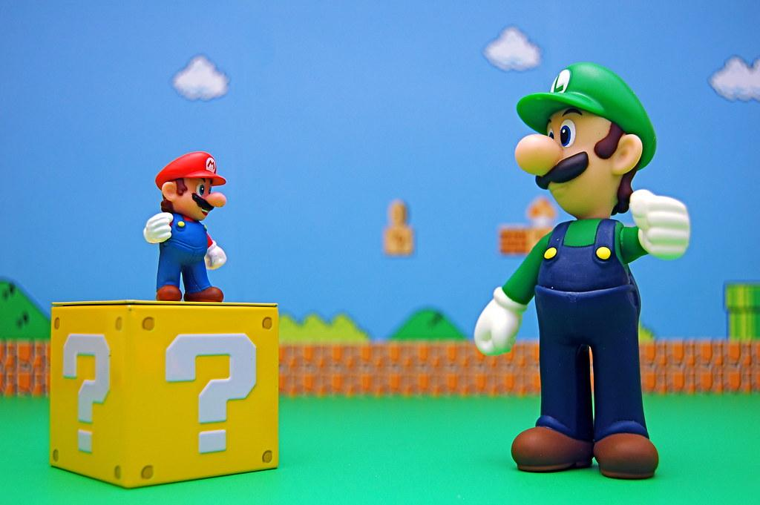
6.NS.1 part 1
Goal
I can divide fractions!

Slide 2
Important Vocabulary
Quotient- a quotient is the answer to a division problem.
Dividend- the number that will be divided by another number
Divisor- the number getting divided in the division problem
Identify the parts of the problem.
56
7
8
Insert your Answer Here
Insert your Answer Here
Insert your Answer Here

Slide 3
More Vocabulary
What is the name for each part
of the fraction?
Numerator- the top number in a fraction. Tells us how many pieces we are working with.
Denominator- The bottom number on a fraction. Tells us how many pieces the item was cut into.
3
Insert your
Answer Here
8
Insert your
Answer Here

Slide 4
Dividing Fractions Introduction
When you divide you are splitting items into even groups. You start with a set dividend (15) and split that into the desired number of groups based of the divisor (5). 15 ÷ 5 = visually this is happening. We start with 15 then put them in 5 equal groups.
Split the dots evenly into the five groups.
Notes:
How many dots are in each group?
Answer Here

Slide 5
Dividing Fractions
While dividing fractions the same thing is happening, but it is easier to do if you think about it in another way. When you divide fractions you are trying to find out how many of the divisor will fit into the dividend. This strategy also works on normal division. We have ½ ÷ ¼ = ? This is asking is how many ¼ section pieces will fit in a ½ section piece. Let’s look at what is happening.
Using the blocks below, drag the ¼ blocks to fill the ½ block below. How many blocks did you use?
One whole object
½ of the same object
¼ of the same object
Answer Here

Slide 6
Dividing Fractions
When you divide fractions sometimes you get an answer the answer does not fit perfectly. When this happens you must break the piece into smaller sections and have a fraction in your answer. Let's try to do ⅓ ÷ ⅛ =
One whole object
⅓ of the same object
⅛ of the same object
How many ⅛ blocks fit into the ⅓ blocks? Drag the blocks to answer the question.
Answer Here
Notes:
Did the blocks fit evenly?
Answer Here
How many full blocks fit in the square?
Answer Here
How could you fill the left over space and get the blocks to fit in evenly?
Answer Here

Slide 7
Dividing Fractions
You could not make even groups because the pieces did not go in evenly. Only two pieces fit completely inside the shape. To fill the remaining space, we will need to cut a piece again to get them to fit evenly. To get an even fit you will take the denominator of the first fraction and multiply it by the numerator of the second fraction. Then cut the piece into that many equal pieces. We cut it into three pieces. Remember when we break the pieces again they become a different fraction altogether from your original fractions used.
Fit the broken pieces into the
remaining area to find a proper fit.
1 ⅓ ⅛ 1/24
Notes:
How many of the cut pieces did you use to fill in the remaining space?
Answer Here

Slide 8
Dividing Fractions
Now let us discover the answer to this problem. We know we used 2 full ⅛ pieces to fill the space. Then we had to cut a piece in three to evenly fit into the space. We used two of the three cut pieces. The answer to the problem is 2 ⅔ pieces to fit properly into the full ⅛ section.
The size of each piece used.
1 ⅓ ⅛ 1/24
Notes:
Drag the pieces into the circles to make three even groups.
How many pieces are in each group?
Answer Here
What total fraction of the whole is represented?
Answer Here

Slide 9
Dividing fractions
Sometimes you may have a fraction that uses more than one on the numerators of the fractions when this happens you simply pull the whole section it refers to.
⅞ ÷ ⅔ =
1 ⅞ ⅔
Notes:
How many ⅔ pieces fit into the ⅞ ?
Answer Here
How many pieces should we break the second ⅔ piece into to get a good fit?
Answer Here

Slide 10
Dividing Fractions
When we multiply the denominator times the numerator we get 8 x 2 = 16. Fit the pieces in to find the answer.
Notes:
What is the answer to ⅞ ÷ ⅔ ?
Answer Here

Slide 11
Solving Practice
½ ÷ 3/12 = Answer Here 2. 4/6 ÷ ½ = Answer Here
3. ⅘ ÷ 1/10 = Answer Here 4. 1÷ ⅛ = Answer Here

Slide 12
6NS.1 part 1
Picture provided from Super Mario Maker 2.
Notes:
Write two questions you have
Additional comments or thoughts

